Slide 1
A line code is the code used for data transmission of a digital signal over a transmission line. This process of coding is chosen so as to avoid overlap and distortion of signal such as inter-symbol interference.
Types of Line Coding
There are 3 types of Line Coding
Unipolar
Polar
Bi-polar

Slide 2
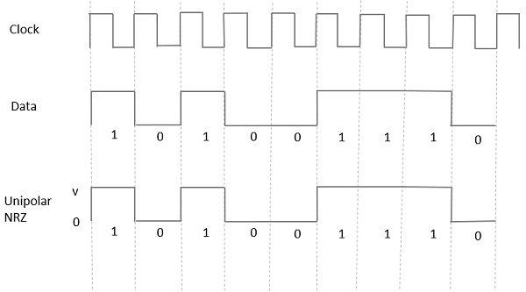
Unipolar Signaling
Unipolar signaling is also called as On-Off Keying or simply OOK. The presence of pulse represents a 1 and the absence of pulse represents a 0.
There are two variations in Unipolar signaling −
Non Return to Zero
In this type of unipolar signaling, a High in data is represented by a positive pulse called as Mark, which has a duration T₀ equal to the symbol bit duration. A Low in data input has no pulse.

Slide 3
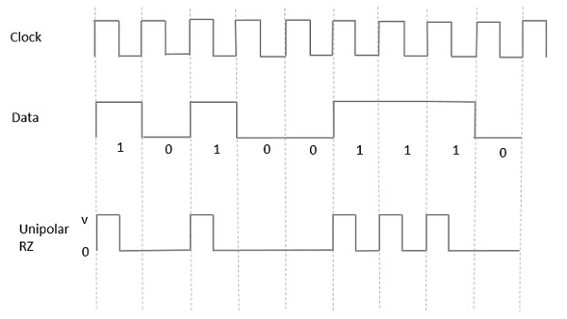
Return to Zero:- In this type of unipolar signaling, a High in data, though represented by a Mark pulse, its duration T0 is less than the symbol bit duration. Half of the bit duration remains high but it immediately returns to zero and shows the absence of pulse during the remaining half of the bit duration.

Slide 4
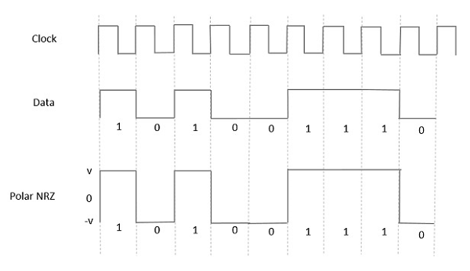
Polar Signaling
There are two methods of Polar Signaling. They are −
Polar NRZ
Polar RZ
Polar NRZ
In this type of Polar signaling, a High in data is represented by a positive pulse, while a Low in data is represented by a negative pulse. The following figure depicts this well.

Slide 5
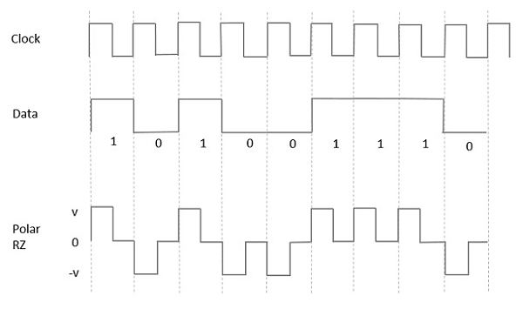
Polar RZ
In this type of Polar signaling, a High in data, though represented by a Mark pulse, its duration T₀ is less than the symbol bit duration. Half of the bit duration remains high but it immediately returns to zero and shows the absence of pulse during the remaining half of the bit duration.

Slide 6
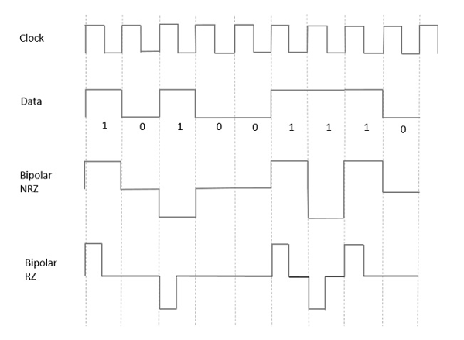
Bipolar Signaling
This is an encoding technique which has three voltage levels namely +, - and 0. Such a signal is called as duo-binary signal.
An example of this type is Alternate Mark Inversion AMI. For a 1, the voltage level gets a transition from + to – or from – to +, having alternate 1s to be of equal polarity. A 0 will have a zero voltage level.
Even in this method, we have two types.
Bipolar NRZ
Bipolar RZ

